Slide 1


Lessons from a Partnership Evaluation
Rachel Eberhard & Suzanne Hoverman
AES Conference, Sydney
31st August – 2nd September, 2011
Hoverman NRM
ALLIANCE

Slide 2
Partnerships……
… a process in which autonomous or semi-autonomous actors interact through formal and informal negotiations, jointly creating rules and structures governing their relationships and ways to act or decide on the issues that brought them together; it’s a process involving shared norms and mutually beneficial interactions.
      Thomson et al, 2007

Slide 3
Why evaluate partnerships?
Growth in partnerships
Governance challenges
Impact of the partnership vs. the partnership itself

Slide 4
Theory of Partnerships
Recommended to negotiate actions across institutions to address wicked policy problems (APSC, 2007)
3 analytical platforms (Selsky & Parker, 2005)
  To access additional competencies
  To engage stakeholders in behavioural change
  Blurring of sectoral boundaries

Slide 5
Theory of Partnerships 2
Diverse typologies – scale, structure, power
Distinct strategies – bureaucratic, entrepreneurial, community-oriented (Herranz, 2009)
Essential elements – trust, reciprocity, mutuality (Thomson et al., 2007)

Slide 6
Context
Natural resource management
Land management for water quality and marine ecological benefits
Partnerships to improve agricultural practices

Slide 7
The partnership
Notes:
Introduce the partners, general roles

Slide 8
Purpose of the Evaluation
Review the processes for
  Collaborative program governance
  Traditional Owner engagement
  Landholder engagement
Make recommendations for improvement of current and expanded (region-wide) programs.
Notes:
Focus on governance

Slide 9
Methodology
Document review
Key Informant Interviews
Attend Partnership workshops – observe interactions
Partnership Assessment Survey – on-line – strategic and operational personnel
Focus Groups
  Landowner groups (3 locations)
  Traditional Owners
Follow up interviews – from survey results, further info
Notes:
Mixed methods, triangulation, different perspectives via roles
KII – history, undercurrents, to inform survey construction
Survey – Wide engagement at all levels, able to be critical, reflective
Distinguish strategic and operational, recipients and land holders
KII also complexity of perceptions

Slide 10
Survey: Partnership Assessment Tool
--Nuffield Institute for Health (Hardy et al. 2000)
1. Recognize and accept the need for partnership
2. Develop clarity and realism of purpose
3. Ensure commitment and ownership
4. Develop and maintain trust.
5. Create clear and robust partnership arrangements
6. Monitor, measure and learn
Notes:
designed explicitly as a devScoring Key: Strongly Agree 4; Agree 3; Disagree 2; Strongly Disagree 1
To what extent do you agree with each of the following six statements in respect of the Partnership which is the subject of this assessment exercise as a whole?
Need for Partnership
• substantial past achievements within the partnership.
• The factors associated with successful working are known and understood.
• Principal barriers are known and understood.
• The extent to which partners engage in partnership working voluntarily or under pressure/mandation is recognised and understood.
• understanding of partners’ interdependence
• understanding of those areas of activity where partners can achieve some goals by working independently
Clarity and Realism of Purpose
clear vision, shared values and agreed service principles.
• We have clearly defined joint aims and objectives.
• These joint aims and objectives are realistic.
• The partnership has defined clear service outcomes.
• The reason why each partner is engaged in the partnership is understood and accepted.
• We have identified where early partnership success is most likely.
ETC from Nuffield Doc

Slide 11
Survey design
Bio-geographic information
Open-ended questions
Diagram of relationships – working or not?
SurveyMonkey – analysis, responses traceable
Notes:
Qualitative: Open ended questions and comments – necessary to understand Likert scale survey questions

Slide 12
Findings
Strategic vs operational levels
  Understanding partnerships, collaboration,
Landholder vs non-landholder
Left out groups
Strategic Oversight group
  Reality of
  Different ideas for strategic oversight group

Slide 13
Results

Slide 14
Evaluation Achieved:
Frank and constructive discussion at results presentation
Operational concerns heard at strategic level
More disadvantaged partners heard
What a partnership could be
Notes:
What a partnership could be:
Renegotiate relationships
Renegotiate purpose
Renegotiate oversight with independence – probity

Slide 15
Evaluation’s Influence
(Many) Recommendations incorporated into the business case for a larger, more comprehensive program protecting Moreton Bay
Some significant recommendations not
Still to be considered by State government
Impacts of floods – delay, loss of personnel, change of priorities

Slide 16
Diverse perspectives
Different goals – waterway health vs sediment transport vs industry productivity vs quality science v community engagement
Different purposes
Different objectives -- strategic vs operational
Notes:
The Healthy Waterways Partnership – planning and science;
• SEQ Catchments Ltd – implementation (through community engagement, undertaking waterway restoration on ground works as well as improved land management practices);
• Queensland Primary Industries and Fisheries, Department of Employment Economic Development and Innovation (DEEDI) – implementation (improved land management practices through the FarmFlow program); with agricultural industry groups as subcontractors, and
•Southeast Queensland Traditional Owners Alliance (SEQTOA) – to involve Traditional Owners in improving the understanding of traditional condition of the three focal areas; in project planning and in the employment of Indigenous work teams in rehabilitation projects.

Slide 17
Reflections on methodology
Survey
  Whose partnership, which bits?
  High levels of neutral responses
  Separation of perspectives useful
Interviews
  Essential for depth of understanding
Focus groups
  Added useful ‘on-ground’ perspective (new views)
  Naïve understanding of higher-level arrangements

Slide 18
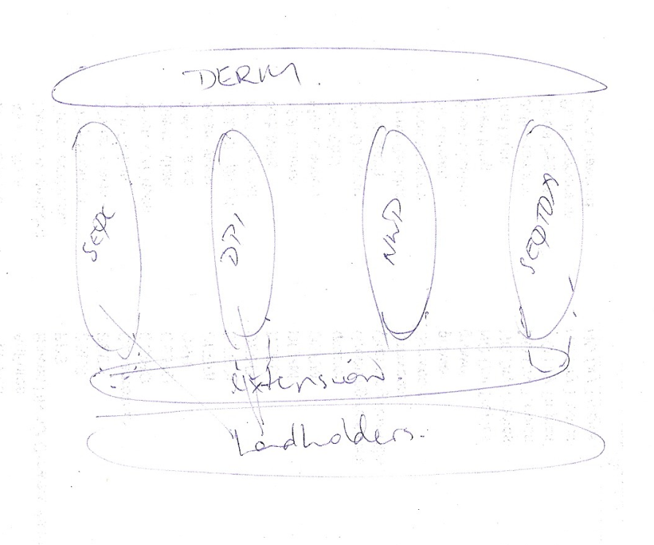
Field coordinator: the theoretical view

Slide 19
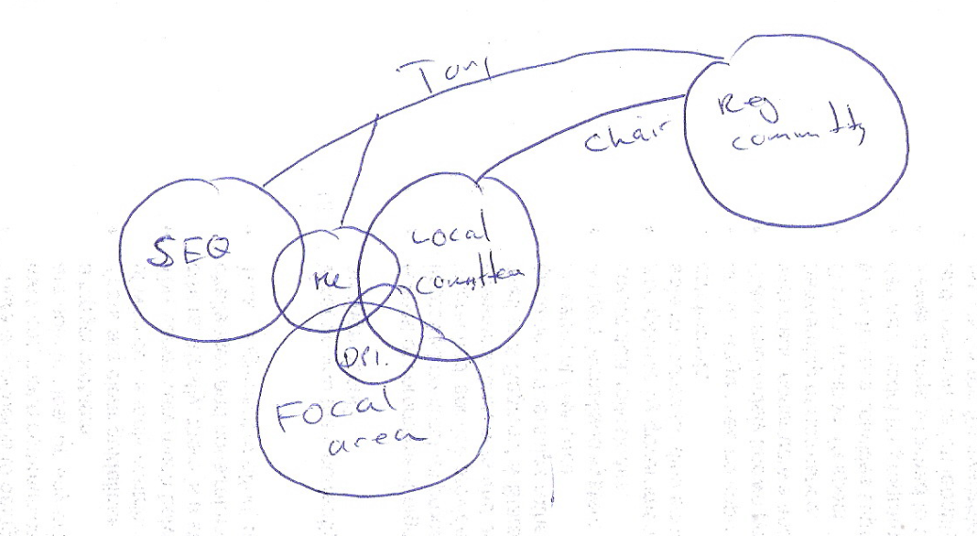
Field coordinator: the community–centric view

Slide 20
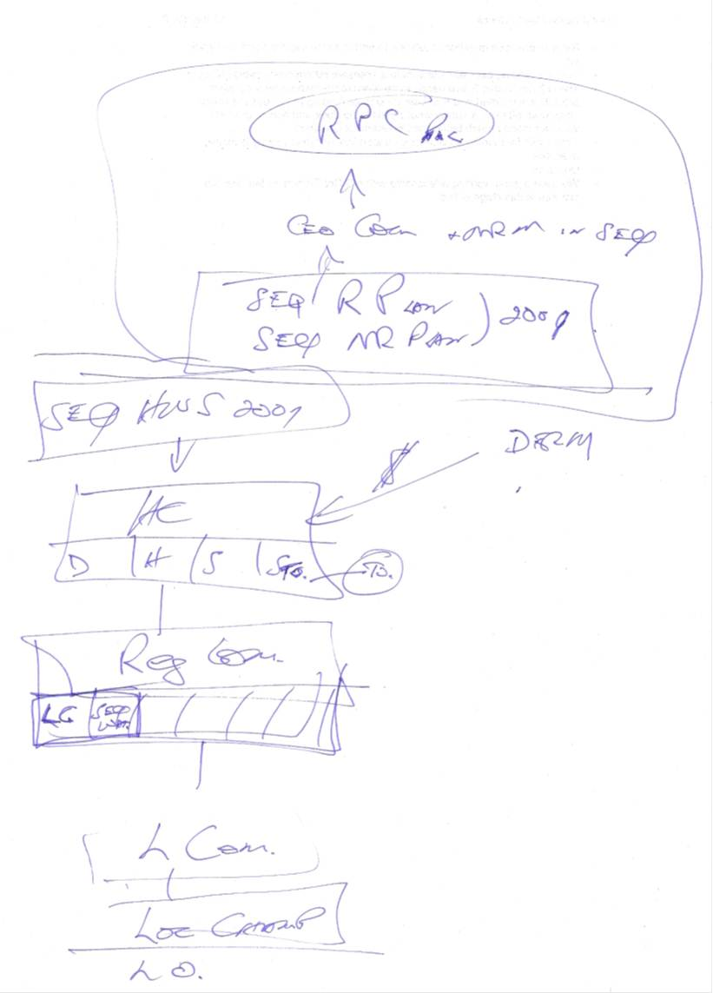
Government investor: the hierarchical view

Slide 21
Implications
Clarification of purpose is fundamental
Recognise life cycle of partnerships
Strategic v. operational behaviours
Mixed methods essential to unpack complex relationships
Facilitatory role of evaluation in partnerships

Slide 22
References
Australian Public Service Commission (2007). Tackling wicked problems. A public policy perspective. Canberra, ACT: Australian Government.
Hardy, B., Hudson, B. and Waddington E. (2000) What makes a Good Partnership? A Partnership Assessment Tool. Leeds: Nuffield Institute for Health.
Halliday, J., Asthana, S.N.M., Richardson, S.( 2004) Evaluating Partnership: The Role of Formal Assessment Tools Evaluation 10: 285
Funnell, S. (2006). Evaluating Partnership Programs – Challenges and Approaches AES International Conference, Darwin, Australia 4 – 7 September 2006
Selsky, J. W., & Parker, B. (2005). Cross-sector partnerships to address social issues: Challenges to theory and practice. Journal of Management, 31(6), 849.

